Slide 1
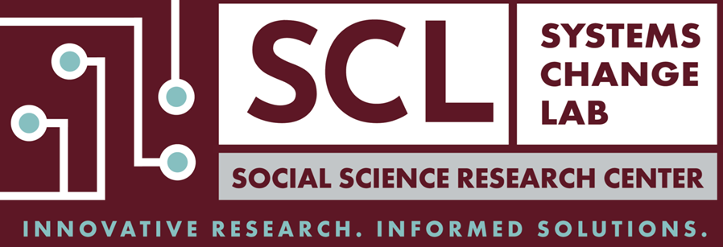

Slide 2
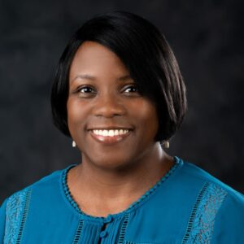
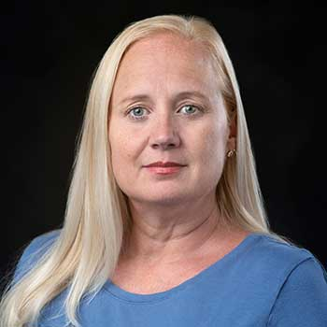
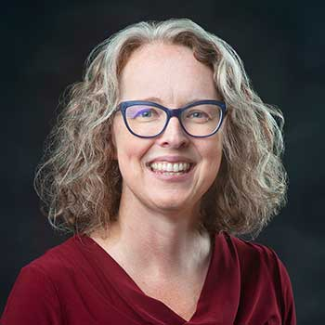
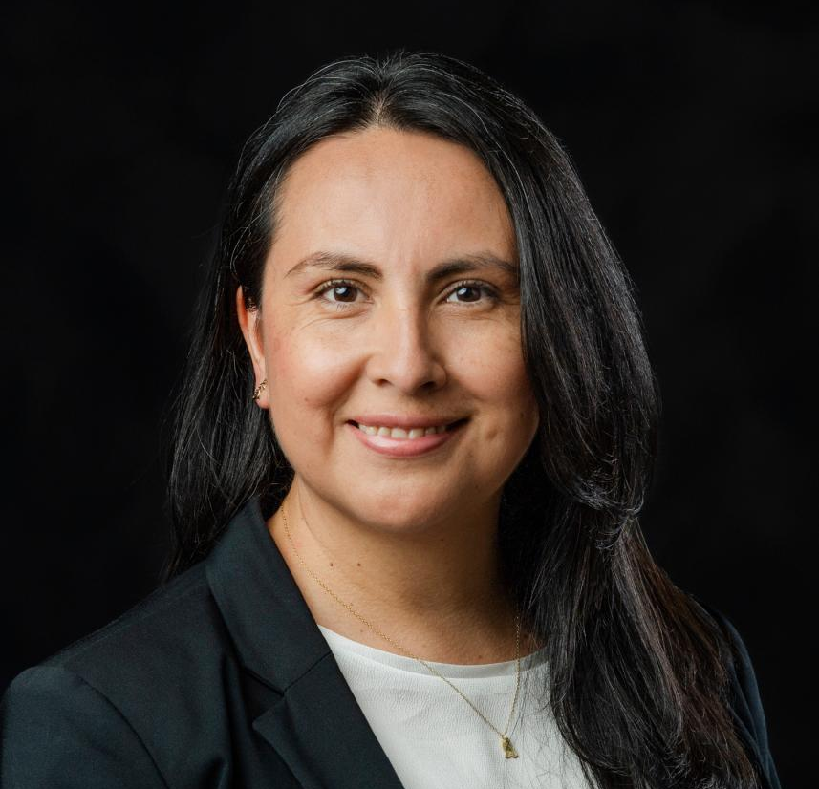
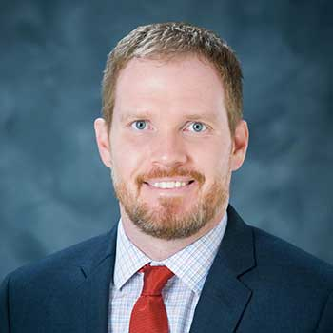
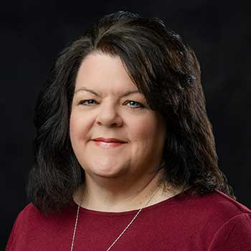
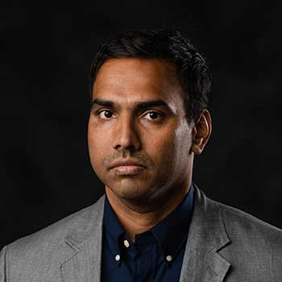
The Systems Change Lab (SCL) at Mississippi State University’s Social Science Research Center is made up of a team of researchers and partners who address complex problems using systems change methodologies.
https://scl.ssrc.msstate.edu

Slide 3
What is a complex problem? Societal problems, such as breakdowns in services for families across multiple organizations and sectors, are said to be complex because there are so many factors that shape them, and no one answer can fix them. They are context-specific and require the input and cooperation of many people.
 | Simple Problem: Following a recipe | Complicated Problem: Sending a rocket to the moon | Complex Problem: Raising a child
Degree to which the solution is formulaic | Formulas are essential. | Formulas are critical. | Formulas have limited application.
Degree to which the solution can be replicated | Recipes are easily replicated. | One successful rocket increases assurance that the next will work. | Raising one child gives experience, but no assurance of success with another.
Dependence of the solution on expertise | Expertise helpful, not required. | High levels of expertise in multiple fields needed. | Expertise can help but is neither essential nor sufficient.
Standardization of the outcome | Produces a standard outcome. | Each outcome is similar in critical ways. | Every outcome is unique.
Certainty of the outcome | There is a high degree of certainty in the outcome. | Once the original issues are solved, there is a reasonable degree of certainty in the outcome. | The outcome is uncertain.
no
Notes:
So as early childhood educators, are you working with complex problems?
Child level—educating very different children
Child care center level—face challenges of funding and resources
Societal level—face challenges of understanding, respect, recognition

Slide 4
What is a system?
“A system is a set of interconnected parts serving a common purpose.” (Valdez, et al., 2024)
Can be a single family, organization, or groups of them, but always with high degree of complexity
For example, the interaction among the families of young children in Mississippi and all the organizations and providers who work to improve children’s outcomes comprise the early childhood system.
Notes:
So if you are one type of provider for children and families within the full EC system,
Can you single-handedly meet all their needs?
Or do you need to become familiar with other resources and providers to connect families to?

Slide 5
What is a system?
We often say that a system is broken, but all systems are functioning to achieve SOME outcome whether it is the desired one or not.
To change the outcomes it is producing, you have to understand the parts of the system, how they are interacting, and what’s holding the problem in place
Notes:
So what do you do if you see that when you refer a family
To a resource that they fall through the cracks and don’t actually get served?
(Try to address it by following up with the other resource…or maybe taking the problem to your legislator if it’s a state-funded resource.)

Slide 6
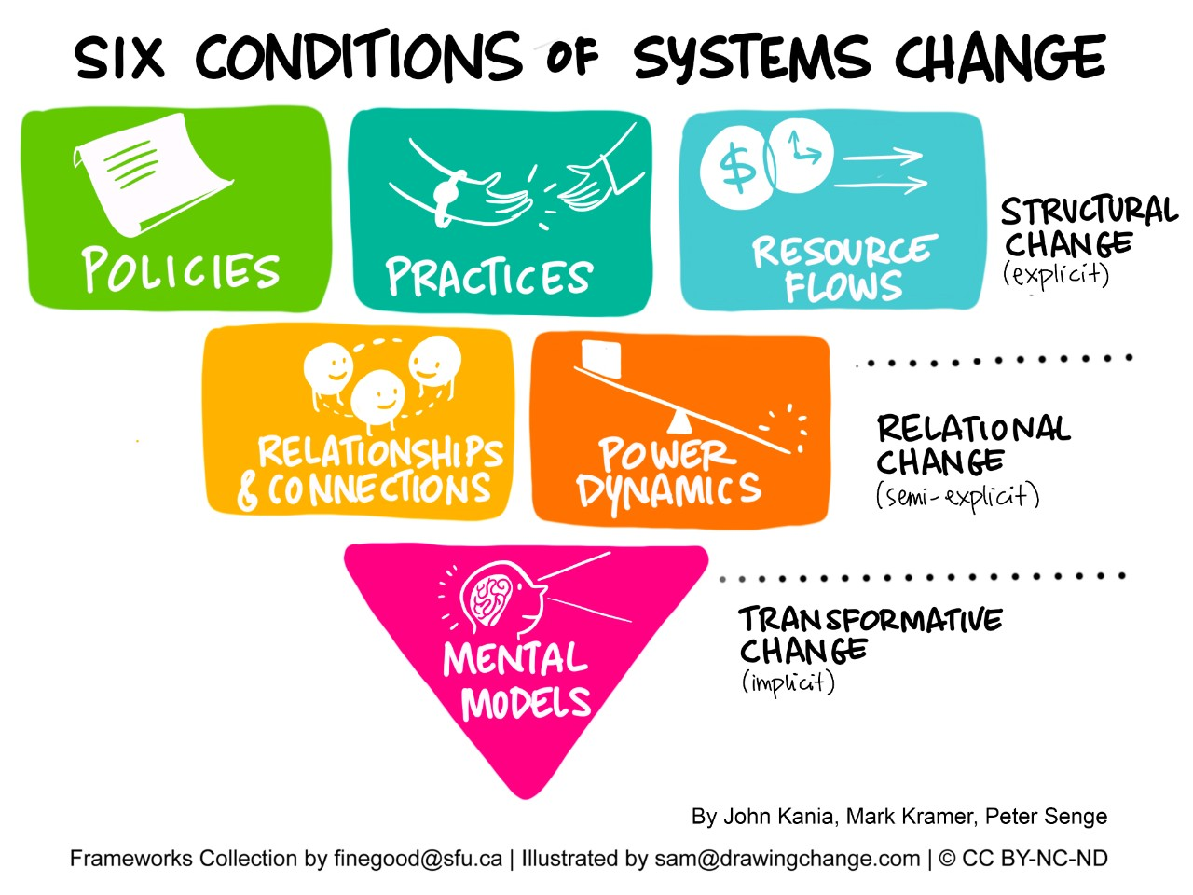
Systems are held in place by six elements, or conditions
Each layer differs in terms of its explicitness, impact, difficulty to change
Notes:
So thinking about a child care center, the director may create a new policy:
Going to have parent meetings once a month…puts a sign up…but no parents come
Why? Maybe the staff didn’t build the relationships or address how parents understand the purpose of the meetings—or hold them at a convenient time
Whose fault is it? The parents or the center?

Slide 7
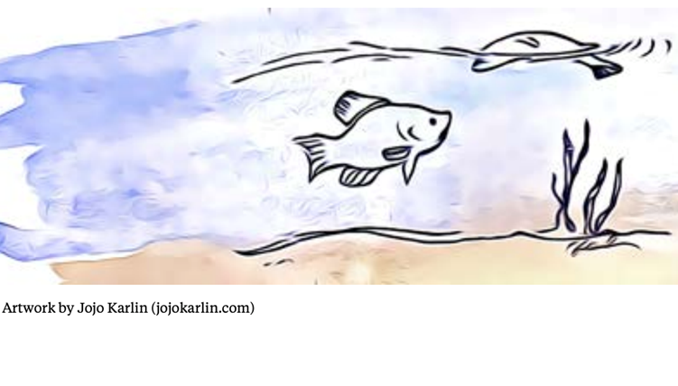
Groundwater approach—Systems Thinking (Love & Hayes Green, 2018)
If one fish belly-up dead in a pond, analyze what’s wrong with it
If the fish is a student doing poorly, ask if maybe it didn’t study or get the right supports at home
If half the fish in a pond are belly-up dead, analyze what’s wrong with the pond
Maybe it’s the school that is the problem
If half the fish are dead across five ponds, analyze what’s wrong with the groundwater
Maybe there are unseen mental models and power dynamics across the entire school system impacting outcomes
Notes:
So a child care center can be a pond, right?
Sometimes have to ask if your practices are meeting the needs of all the fish!
Instead of blaming the fish. And the fish’s mama. ☺

Slide 8
What is systems change?
“Systems change occurs when the parts of a system and the relationships between them are intentionally changed to produce significantly different and improved conditions and results.” (Valdez, et al., 2024)
Notes:
So you might start to see some issues that you want to address
And you start to think about how to bring about change
Let’s say you notice that early childhood educators are not well paid. That’s a big, complex problem. How could you try to address this?

Slide 9
How can we bring about systems change?
1) Embrace System Complexity
There is no simple series of steps that you can follow, but there are some elements and methods you can use to address complex problems.

Slide 10
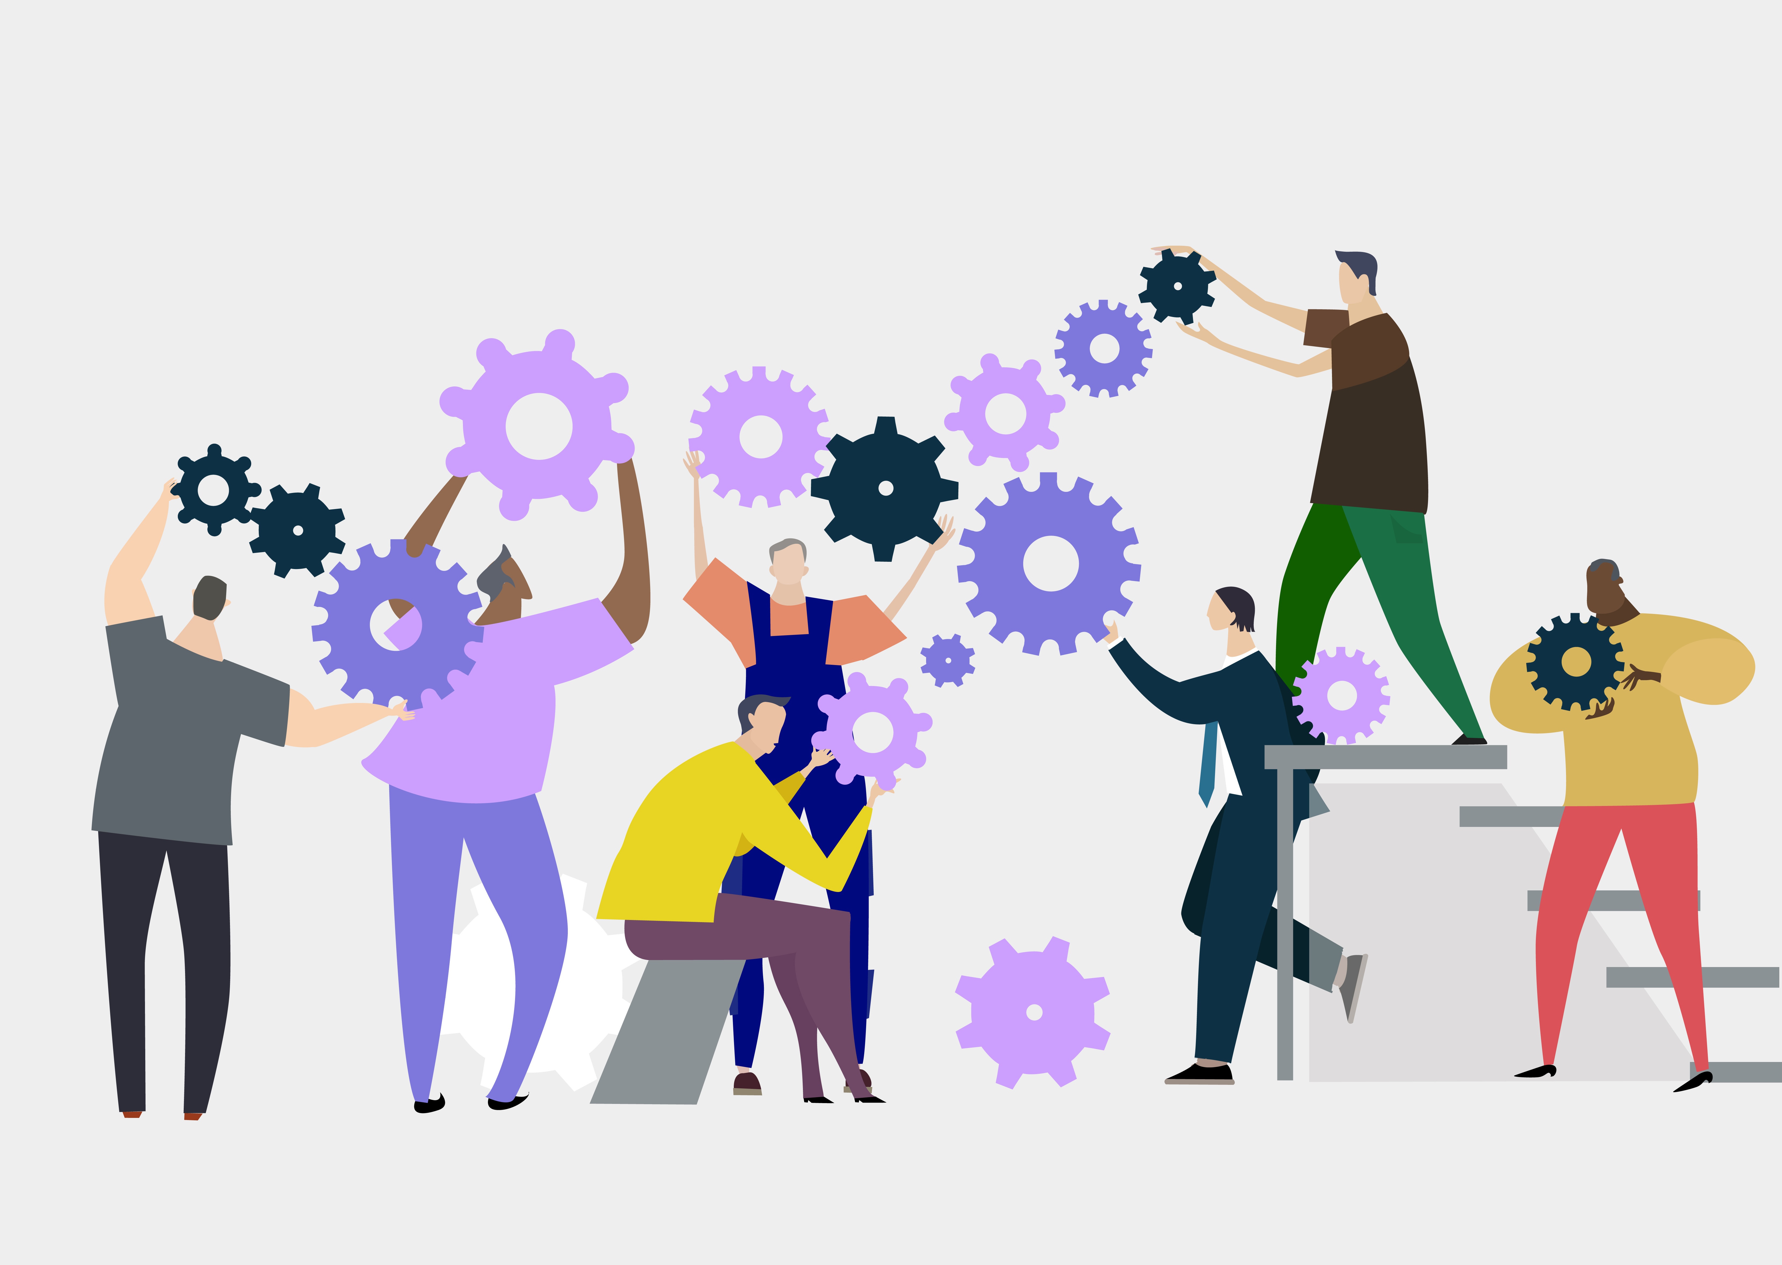
2. Invest in systems change leadership
Backbone supporters facilitate the work and help set the stage for productive dialogue. They must:
Understand system change processes and methods
Facilitate collective sense-making and action

Slide 11
relational work of
systems change
(Milligan, Zerda, Kania)
Backbone supporters must also:
Attend to relational and power dynamics and ensure respectful member interactions
Build consensus and create information feedback loops

Slide 12
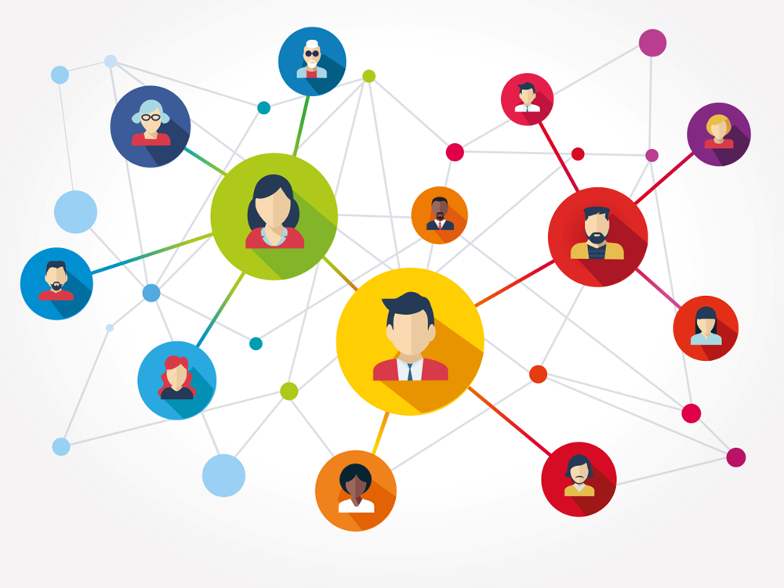
3. Identify those closest to the challenge: Actor Mapping
Who are the actors/stakeholders in this system? (may be individuals or organizations)
Think about: those with lived experience of the system (end users), those with the power to make decisions, those who work in the system, those who benefit from it
What are the relationships among the actors?

Slide 13
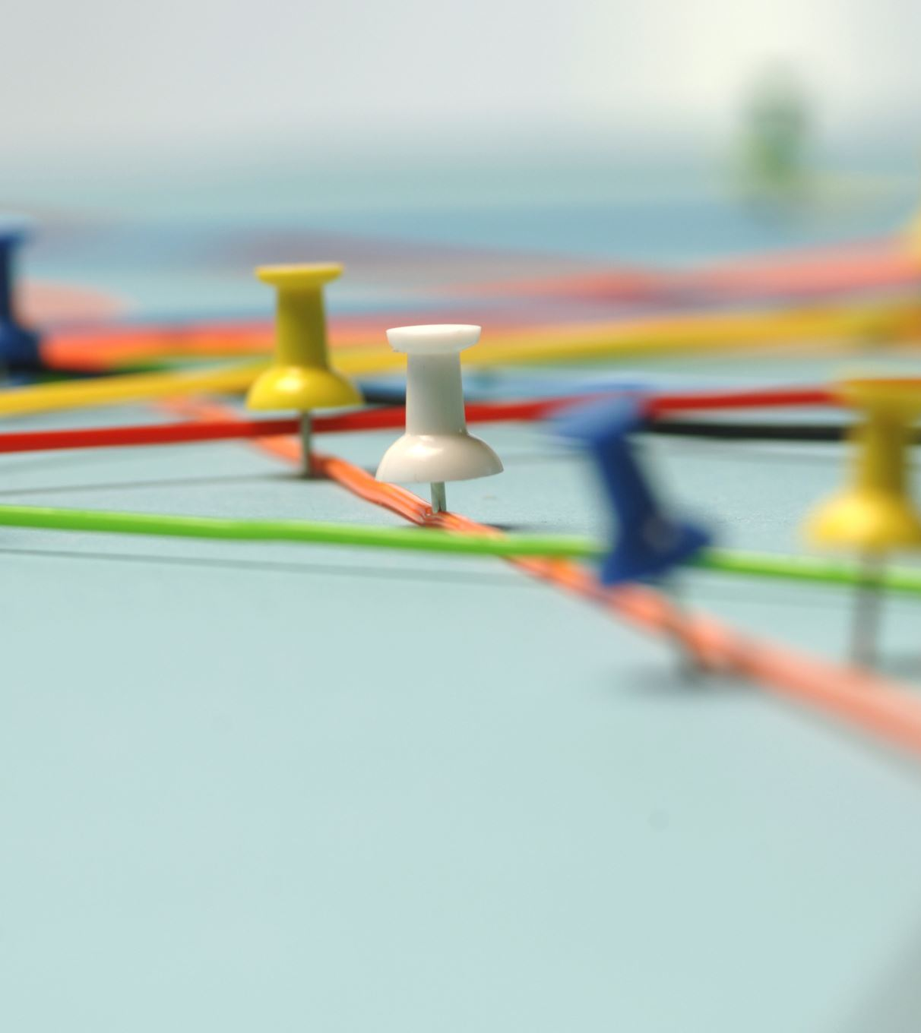
Selecting Representatives among Actors
At times, you will have large groups of actors, such as child care providers or pediatricians, that you will want to select among for representatives to assist with systems change work.
Fair Selection Process:
Use clear criteria and an open application process for all who qualify
Ensure representatives reflect the full group’s demographics.
Allow members to nominate and vote for representatives.

Slide 14
4. Understand root causes of the challenge: Building a Shared Understanding
Creating a Shared View: Once stakeholders are selected, bring them together to map the system and its challenges.
The EC Cruise Ship Analogy: Each stakeholder sees the system from a different perspective—like looking through separate portholes on a ship. Some see turtles, others see algae, and some see a sunken ship. By sharing these views, you create a complete picture of the system.

Slide 15
Building Shared understanding: Landscape analysis
Thinking Geographically
Identify all elements—human and non-human—within the system: what is the infrastructure of this system?
Examine the interactions among the elements
Gather available data about system outcomes
Can create a visual map of the system based on this information
Infrastructure
Resources
People/Organizations
Notes:
Early childhood system impacting pay:
Child care centers, directors, teachers
Children & families
MDHS subsidy program
Local schools who benefit from high-quality EC educators when receive children
Businesses who benefit from high quality teachers
Shared Services Program

Slide 16
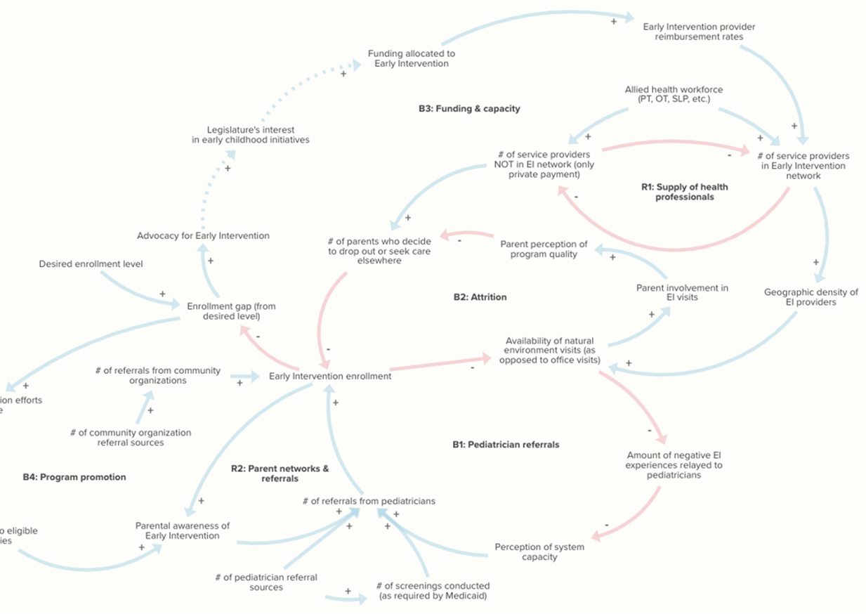
Building Shared Understanding: Group Model Building
Convene stakeholders to identify system elements and how they interact and affect each other to produce a particular outcome
Emphasizes collaboration and consensus-building among diverse stakeholders to develop strategies and solutions
Results in a co-created systems map that identifies root causes and potential interventions
Notes:
Early Intervention in Mississippi​: Causal Loop Diagram of System/Semester exercise between SSRC and students at Brown School at Washington University
Can look at all the attitudes, relationships, power dynamics, policies, processes, resources (6 conditions) & how they hold the problem in place

Slide 17
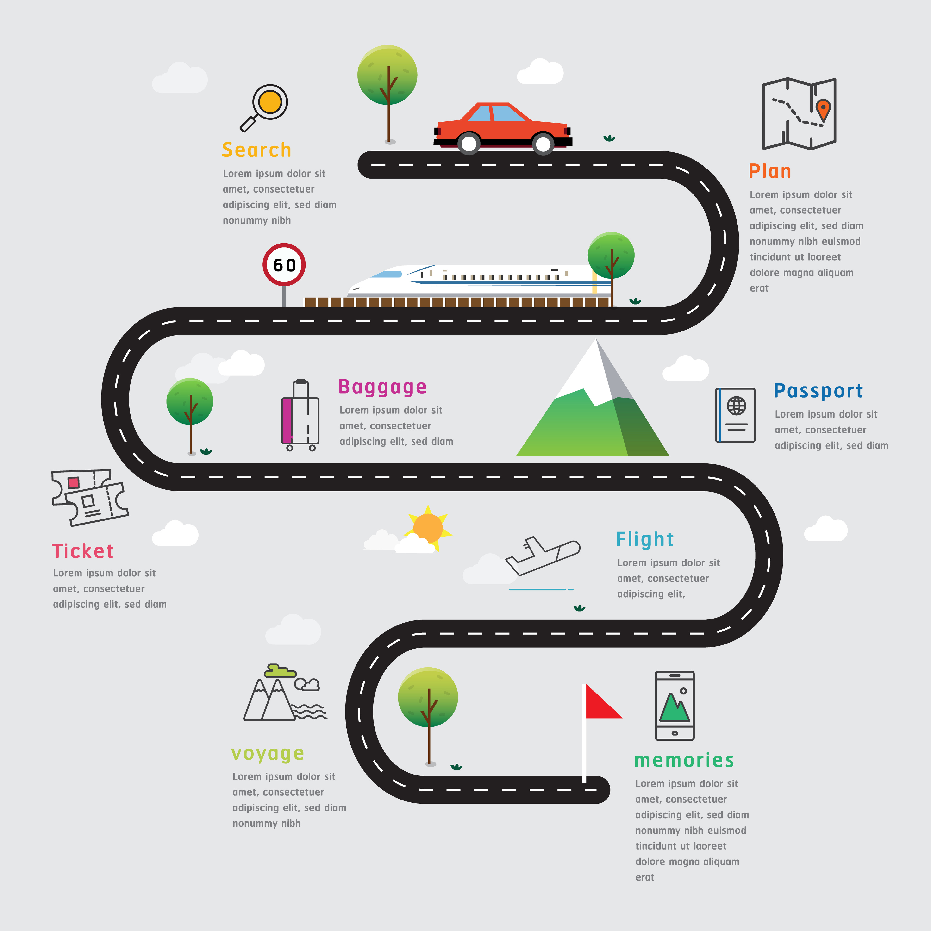
Building Shared Understanding: Journey Mapping Helpful to look at how end users move through the current system vs. the ideal way they should move through the system. Can “map the gaps.”
Notes:
Related to EC educator pay…could look at the career pathways of educators and how they impact earnings
What is the ideal vs where we are & how can we close the gaps?

Slide 18
Building Shared Understanding: Additional Research
These efforts may point to a need for additional information gathered through research to fill in the missing information that’s need to understand how the system currently operates and how it can best be improved.
Primary or secondary data collection—for example, may need to interview system leaders, survey end users, etc.

Slide 19
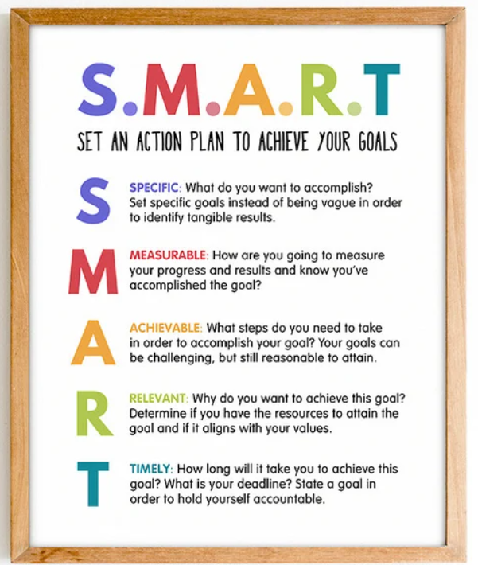
5. Work together to address the Challenge through Systems Alignment
“…alignment occurs when all policies, practices, processes, resources, and roles in a system work together in similar or consistent ways…” to produce a desired outcome (Valdez, 2024)
Will need to divide the work to try to address the areas identified for change, create smart goals for achieving the change, and remember to target all six conditions of systems change in the plan (policies, processes, resource flows, relationships, power dynamics, mental models).

Slide 20
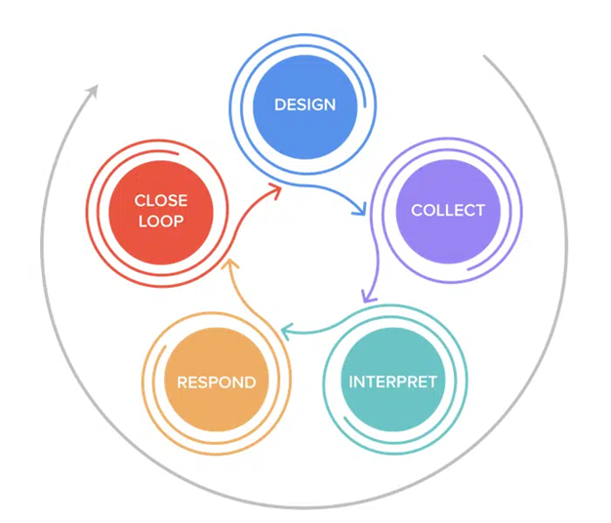
6. Use closed feedback loops to continually improve
As you implement the changes to the system, use a feedback loop to continually to collect data from system stakeholders and refine the system to ensure ongoing system alignment.
Closed feedback loops ensure you circle back with the stakeholders to inform them of the actions taken and to get additional feedback for continuous quality improvement.
Image from https://listen4good.org/feedback101/what-is-a-feedback-loop-gathering-feedback-from-nonprofit-clients/
Notes:
For EC educator pay…talk to providers to see how working out
Might get a $1.00 raise that bumps them off of SNAP benefits & they are worse off

Slide 21
RESOURCES & CONTACT INFO
Article: Systems Archetypes by Mikayla Branz, Allie Farrell, Min Hu William Liem, Ellis Ballard
Book: Systems Thinking for Social Change by David Peter Stroh
Book: Community-Based System Dynamics by Peter S. Hovmand
Book: Results Based Facilitation: Book 1 Foundational Skills by Jolie Bain Pillsbury
Brief: Systems Change at WestEd– Six Guiding Principles
Brief: Overview of Participatory Systems Change for Equity from WestEd
Toolkit: Putting Systems Thinking into Place in Your Organization from FSG
Toolkit: Systems Practice by the Omidyar Group
Heather Hanna: heather.hanna@msstate.edu
Notes:
End

